Slide 1
Introducing High Availability Clustering

Slide 2
Understanding HA Clustering
The cluster runs a service on a node
High-availability requirements
multiple nodes
fence devices
networking
dedicated cluster interface
ethernet bonding
shared storage
Red Hat HA add-on
Red Hat HA Add-on components
Corosync
rgmanager
Pacemaker
Conga

Slide 3
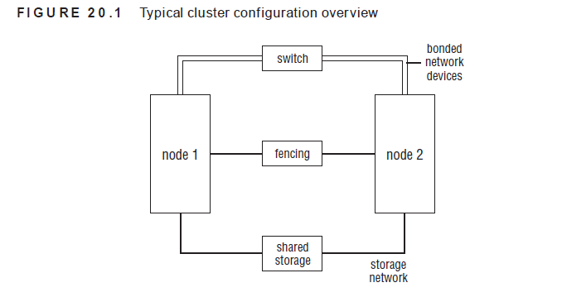

Slide 4
Multiple Nodes
A typical cluster uses at least two nodes, with a maximum number of 16 nodes.
Some administrators like to work with three nodes as the minimum. This is to ensure that quorum can be maintained at all times.
Quorum is also an important element in an HA cluster. It is the minimum number of nodes that must be available to continue offering services.
Typically, the quorum consists of half-plus-one nodes. That is, a node needs majority in the cluster to be able to continue offering services.

Slide 5
Fence Devices
A fencing device is typically a hardware device, which is available to shut down another node, even if the node itself has failed.
Common solutions include power switches or integrated management cards, such as HP ILO or Dell DRAC
Fencing is also referred to as STONITH, which stands for Shoot The Other Node In The Head. This is exactly what STONITH will do if a node needs to be shut down to prevent corruption from occurring on your cluster.

Slide 6
A Dedicated Cluster Interface
A dedicated cluster network is often created.
This ensures that cluster packets will always get through no matter what happens on the user network. To increase fault tolerance, the user network can serve as a backup for the cluster traffic

Slide 7
Ethernet Bonding
A network card can always fail.
To minimize the impact of this and to get more bandwidth, Ethernet bonding is often used in HA cluster environments.
An Ethernet bond is a logical device that groups at least two network cards. When configuring this, you choose a protocol that specifies how the bond should work.

Slide 8
Shared Storage
Most services that run in your cluster will need access to files. When the service fails over, these files will also need to be available on the target server.
Many companies have a proprietary Fibre Channel or iSCSI SAN that is used as shared storage

Slide 9
Red Hat High-Availability Add-on Software Components
Corosync
Corosync takes care of the lower layers of the cluster.
It uses the Totem protocol to ensure that all nodes in the cluster are still available.
If something goes wrong on the Corosync layer, it will notify the upper layers of the cluster,

Slide 10
Rgmanager
Rgmanager refers to the upper layers of the cluster.
It consists of different processes, which ensure that services are running where they should be.
If Corosync detects a failure on the cluster, the Rgmanager layer will move the services to a node where they can continue to do their work.

Slide 11
Pacemaker
Rgmanager is the traditional Red Hat HA cluster stack. There is another Linux-based HA solution, however, which is known as Pacemaker

Slide 12
Conga
Conga is the management interface that is used to create and manage clusters.
It consists of two parts: ricci and luci.
Ricci is the agent that should be installed on all nodes in the cluster
luci is the management application that talks to ricci.
As an administrator, you’ll log in to the luci web interface to create and manage your cluster.

Slide 13
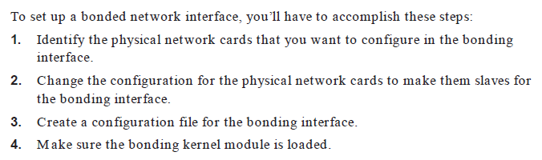
Configuring Cluster-Based Services
Setting Up Bonding

Slide 14
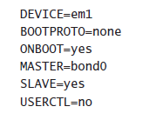
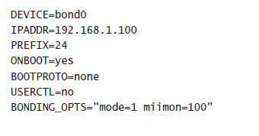

Slide 15
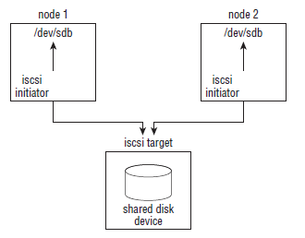
Setting up an iSCSI target
Make sure a dedicated device is available
After verifying that you have unallocated storage, use
lvcreate -n iscsivol –L 10G /dev/yourvgname. creates a 10GB volume

Slide 16
Install scsi-target-utils
yum install -y scsi-target-utils
Modify /etc/tgt/targets.conf
<target iqn.2012-12.com.example.san:mytarget>
backing-store /dev/myvolumegroup/iscsivol
</target>
service tgtd start
chkconfig tgtd on

Slide 17
Setting Up the iSCSI Initiator
To create the iSCSI connections, use the iscsiadm command. This command stores its configuration in a database
To manage connections to an iSCSI SAN, there are four different iSCSI commands
iscsiadm --mode discoverydb --type sendtargets --portal 192.168.1.70 --discover
This command connects to the IP address that is specified with the –portal option and discovers all iSCSI targets

Slide 18


iscsiadm --mode node --targetname iqn.2012-8.com.example.san:mytarget –portal 192.168.1.70 –login
This command uses the target name that was discovered with the previous command to make a connection to the iSCSI target

Slide 19
iscsiadm --mode node --targetname iqn.2012-8.com.example.san:mytarget –portal 192.168.1.70 –logout
iscsiadm --mode node --targetname iqn.2012-8.com.example.san:mytarget –portal 192.168.1.70 –delete
you can request current status parameters about the connection.
iscsiadm --mode discoverydb -Shows information about the targets that have been discovered
iscsiadm --mode node - Shows which targets this node is configured to connect to
iscsiadm --mode session - Shows all sessions that are currently existing

Slide 20

Connecting to an iSCSI Initiator
yum install iscsi-initiator-utils
to install the iSCSI initiator on all nodes
iscsiadm --mode discoverydb --type sendtargets --portal 192.168.1.70 --discover
to get a list of targets that are available on that IP address
iscsiadm --mode node --targetname iqn.2012-8.com.example.san:mytarget --portal 192.168.1.70 –login
Use yum -y install lsscsi to install the lsscsi package,
enter lsscsi to verify that you are connected to the target.

Slide 21

Installing the Red Hat High Availability Add-on
Creating an /etc/hosts File
create an /etc/hosts file with the following contents
Use scp to copy the file to all other nodes in the cluster
scp /etc/hosts 192.168.1.80:/etc

Slide 22
Creating a Cluster with Conga
Setup Conga to create the cluster
ricci is the agent that runs on all nodes
luci is the cluster management software
/etc/cluster/cluster.conf contains the cluster configuration
service NetworkManager stop
chkconfig NetworkManager off on all nodes.
On all nodes, use yum install -y ricci to install ricci.
Service ricci start to start the service
chckconfig ricci on
use passwd ricci
to set a password for the user ricci and set the password to password

Slide 23
yum install luci
service luci start
While star ting luci for the first time, a public/private key pair is generated and installed. The name of this certificate is /var/lib/luci/certs/hosts.pem, and it is referred to in the configuration file /var/lib/luci/etc/cacert.config

Slide 24
After generating the certificates, luci will start and offer its services on HTTPS port 8084.
Launch a browser, and connect to https://yourserver:8084 to get access to the luci management interface.

Slide 25
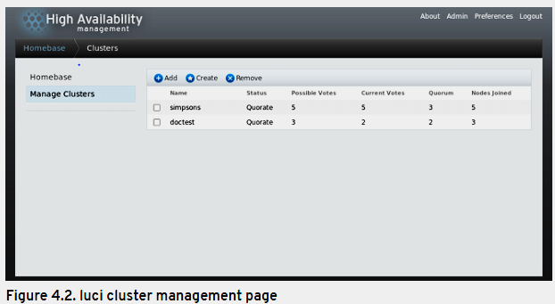

Slide 26
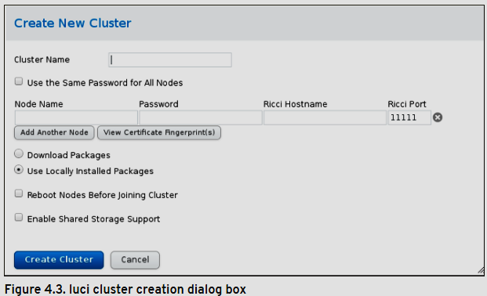

Slide 27
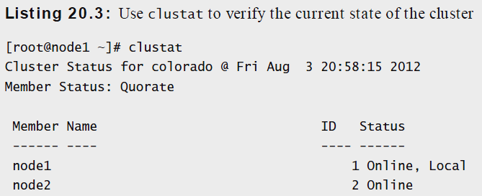
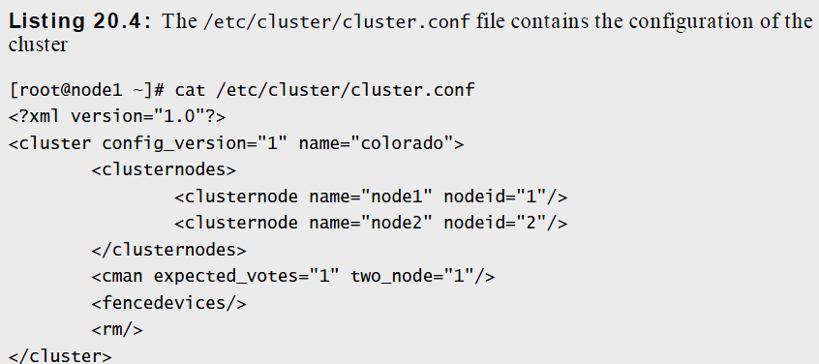

Slide 28
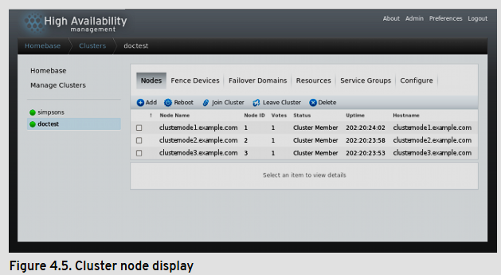

Slide 29
A cluster quorum disk is the storage medium on which the configuration database is stored for a cluster computing network. The cluster configuration database, also called the quorum, tells the cluster which physical server(s) should be active at any given time.

